Slide 1
Visualizing Joins and Subqueries

Slide 2
INNER JOIN
Visualizing Inner Joins

Slide 3
INNER JOIN
Select Student full names and the course ID's they are registered in.
Visualizing Inner Joins

Slide 4
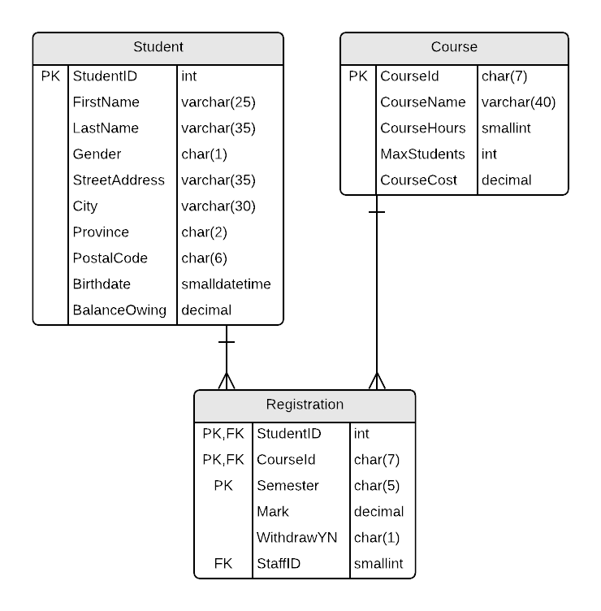
Select Student full names and the course ID's they are registered in.

Slide 5

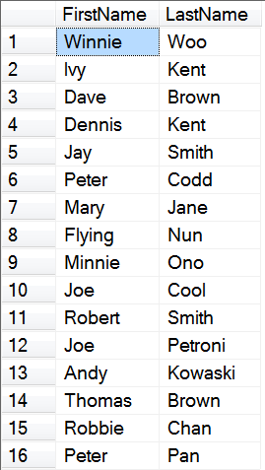

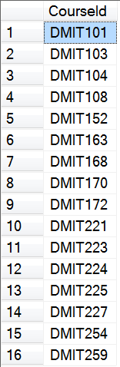
Select Student full names and the course ID's they are registered in.
To retrieve the data in a single SELECT statement, we need to JOIN the tables.

Slide 6
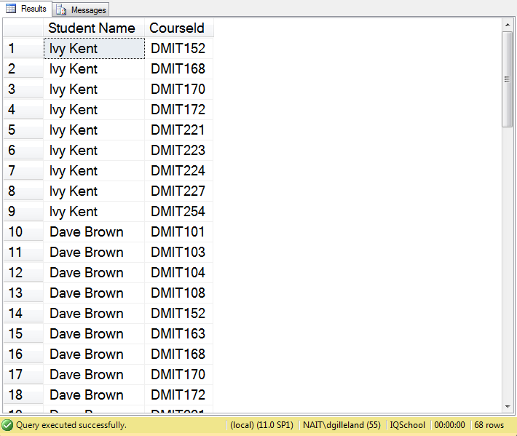
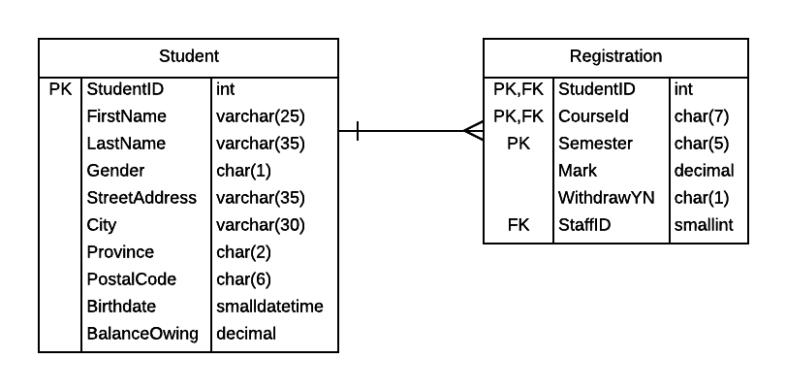
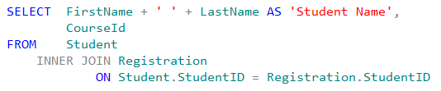
Select Student full names and the course ID's they are registered in.
JOIN
ON
Notes:
SELECT stores.stor_id 'Store ID',
stores.stor_name 'Store',
stores.city 'City',
stores.state 'State'
FROM stores
SELECT sales.stor_id 'Store ID',
sales.ord_num 'Order No.',
sales.title_id 'Title Id.',
sales.qty 'Quantity'
FROM sales
SELECT stores.stor_id 'Store ID',
stores.stor_name 'Store',
stores.city 'City',
stores.state 'State',
sales.ord_num 'Order No.',
sales.title_id 'Title Id.',
sales.qty 'Quantity'
FROM stores
INNER JOIN sales
ON stores.stor_id = sales.stor_id

Slide 7
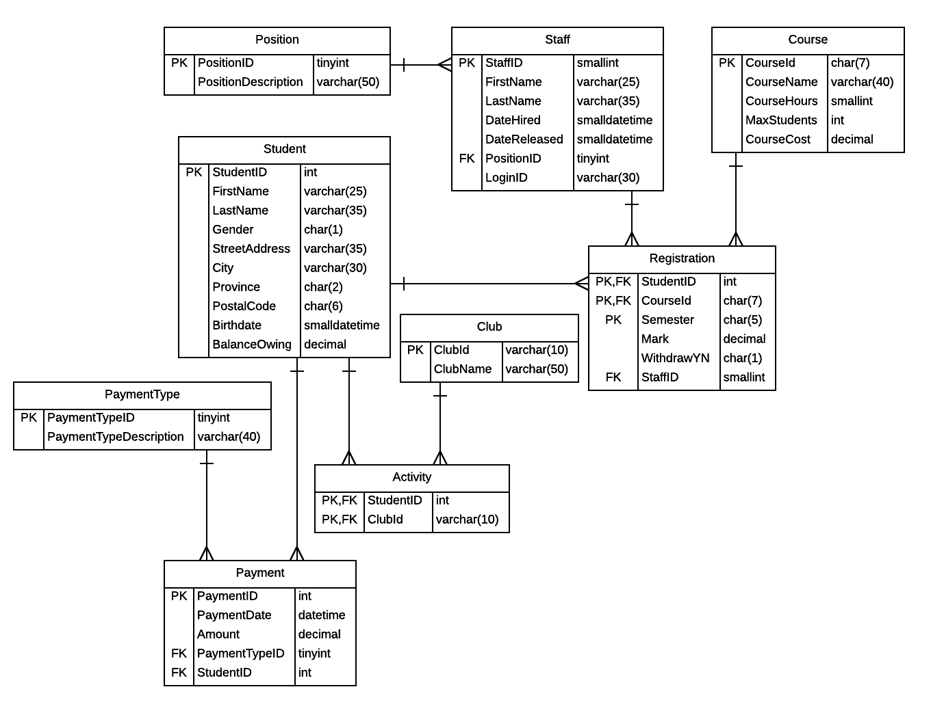
Select the club name and student id for all clubs that students are registered in.
Which table(s) contain the data that we want to retrieve?

Slide 8
Select the club name and student id for all clubs that students are registered in.
SELECT ClubId, ClubName
FROM Club
ClubId | ClubName
ACM | Association of Computing Machinery
CHESS | NAIT Chess Club
CIPS | Computer Info Processing Society
CSS | Computer System Society
DBTG | DataBase Task Group
NAITSA | NAIT Student Association
NASA | NAIT Staff Association
NASA1 | NAIT Support Staff Association

Slide 9
Select the club name and student id for all clubs that students are registered in.
SELECT StudentID, ClubId
FROM Activity
StudentID | ClubId
199899200 | CSS
199912010 | ACM
199912010 | CSS
199912010 | NASA
200312345 | CSS
200322620 | ACM
200322620 | CSS
200495500 | ACM
200495500 | CHESS
200495500 | CSS

Slide 10
Select the club name and student id for all clubs that students are registered in.
SELECT ClubId, ClubName
FROM Club
SELECT StudentID, ClubId
FROM Activity
ClubId | ClubName
ACM | Association of Computing Machinery
CHESS | NAIT Chess Club
CIPS | Computer Info Processing Society
CSS | Computer System Society
DBTG | DataBase Task Group
NAITSA | NAIT Student Association
NASA | NAIT Staff Association
NASA1 | NAIT Support Staff Association
StudentID | ClubId
199899200 | CSS
199912010 | ACM
199912010 | CSS
199912010 | NASA
200312345 | CSS
200322620 | ACM
200322620 | CSS
200495500 | ACM
200495500 | CHESS
200495500 | CSS

Slide 11
Select the club name and student id for all clubs that students are registered in.
SELECT C.ClubId, ClubName, StudentID, A.ClubId
FROM Club C
INNER JOIN Activity A
ON C.ClubId = A.ClubId
ClubId | ClubName
ACM | Association of Computing Machinery
CHESS | NAIT Chess Club
CIPS | Computer Info Processing Society
CSS | Computer System Society
DBTG | DataBase Task Group
NAITSA | NAIT Student Association
NASA | NAIT Staff Association
NASA1 | NAIT Support Staff Association
StudentID | ClubId
199899200 | CSS
199912010 | ACM
199912010 | CSS
199912010 | NASA
200312345 | CSS
200322620 | ACM
200322620 | CSS
200495500 | ACM
200495500 | CHESS
200495500 | CSS
An INNER JOIN only selects rows from the tables where there is a match based on the joining column.
INNER means that there must be rows of data in both tables.

Slide 12
Select the club name and student id for all clubs that students are registered in.
SELECT C.ClubId, ClubName, StudentID, A.ClubId
FROM Club C
INNER JOIN Activity A
ON C.ClubId = A.ClubId
C.ClubId | ClubName | StudentID | A.ClubId
ACM | Association of Computing Machinery | 199912010 | ACM
ACM | Association of Computing Machinery | 200322620 | ACM
ACM | Association of Computing Machinery | 200495500 | ACM
CHESS | NAIT Chess Club | 200495500 | CHESS
CSS | Computer System Society | 199899200 | CSS
CSS | Computer System Society | 199912010 | CSS
CSS | Computer System Society | 200312345 | CSS
CSS | Computer System Society | 200322620 | CSS
NASA | NAIT Staff Association | 199912010 | NASA

Slide 14
LEFT OUTER JOIN
Visualizing Outer Joins

Slide 15
Select all the club names and the IDs of the students that are registered in them.
SELECT C.ClubId, ClubName, StudentID, A.ClubId
FROM Club C
LEFT OUTER JOIN Activity A
ON C.ClubId = A.ClubId
Club is the “left” table
ClubId | ClubName
ACM | Association of Computing Machinery
CHESS | NAIT Chess Club
CIPS | Computer Info Processing Society
CSS | Computer System Society
DBTG | DataBase Task Group
NAITSA | NAIT Student Association
NASA | NAIT Staff Association
NASA1 | NAIT Support Staff Association
StudentID | ClubId
199899200 | CSS
199912010 | ACM
199912010 | CSS
199912010 | NASA
200312345 | CSS
200322620 | ACM
200322620 | CSS
200495500 | ACM
200495500 | CHESS
200495500 | CSS
An OUTER JOIN selects rows from the tables whether-or-not there is a match based on the joining column.
LEFT OUTER means that all the rows from the left table (Club) are included in the result.

Slide 16
Select all the club names and the IDs of the students that are registered in them.
SELECT C.ClubId, ClubName, StudentID, A.ClubId
FROM Club C
LEFT OUTER JOIN Activity A
ON C.ClubId = A.ClubId
C.ClubId | ClubName | StudentID | A.ClubId
ACM | Association of Computing Machinery | 199912010 | ACM
ACM | Association of Computing Machinery | 200322620 | ACM
ACM | Association of Computing Machinery | 200495500 | ACM
CHESS | NAIT Chess Club | 200495500 | CHESS
CIPS | Computer Info Processing Society | null | null
CSS | Computer System Society | 199899200 | CSS
CSS | Computer System Society | 199912010 | CSS
CSS | Computer System Society | 200312345 | CSS
CSS | Computer System Society | 200322620 | CSS
DBTG | DataBase Task Group | null | null
NAITSA | NAIT Student Association | null | null
NASA | NAIT Staff Association | 199912010 | NASA
NASA1 | NAIT Support Staff Association | null | null

Slide 18
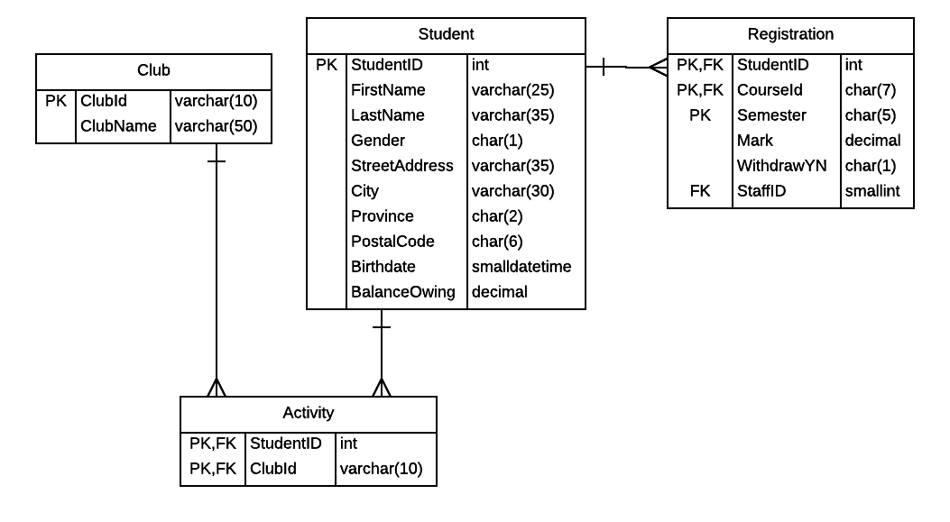
There are some scholarship opportunities for club members in second term courses. List all the candidates (name, id, avg mark) having a course average over 70% in their second term courses, from highest to lowest average.
SELECT FirstName, LastName, S.StudentID, AVG(Mark) AS 'Average'
FROM Club C
INNER JOIN Activity A ON C.ClubId = A.ClubId
INNER JOIN Student S ON A.StudentID = S.StudentID
INNER JOIN Registration R ON S.StudentID = R.StudentID
WHERE R.CourseId LIKE '____2%'
GROUP BY FirstName, LastName, S.StudentID
HAVING AVG(Mark) > 70
ORDER BY 'Average' DESC
JOIN
ON

Slide 19
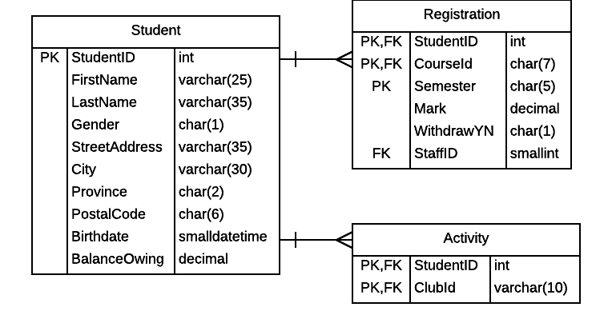
There are some scholarship opportunities for club members in second term courses. List all the candidates (name, id, average mark) having a course average over 70% in their second level courses, from highest to lowest average.
SELECT FirstName, LastName, S.StudentID, AVG(Mark) AS 'Average'
FROM Activity A
INNER JOIN Student S ON A.StudentID = S.StudentID
INNER JOIN Registration R ON S.StudentID = R.StudentID
WHERE R.CourseId LIKE '____2%'
GROUP BY FirstName, LastName, S.StudentID
HAVING AVG(Mark) > 70
ORDER BY 'Average' DESC
G
W
AVG ( )
H
S
Notes:
-- Paste into new Query Window:
SELECT FirstName, LastName, S.StudentID, Mark
FROM Student S
INNER JOIN Registration R ON S.StudentID = R.StudentID
SELECT *
FROM Activity A
INNER JOIN Student S ON A.StudentID = S.StudentID
INNER JOIN Registration R ON S.StudentID = R.StudentID
SELECT FirstName, LastName, A.StudentID, Mark
FROM Activity A
INNER JOIN Student S ON A.StudentID = S.StudentID
INNER JOIN Registration R ON S.StudentID = R.StudentID
SELECT FirstName, LastName, S.StudentID, AVG(Mark) AS 'Average'
FROM Activity A
INNER JOIN Student S ON A.StudentID = S.StudentID
INNER JOIN Registration R ON S.StudentID = R.StudentID
GROUP BY FirstName, LastName, S.StudentID
SELECT FirstName, LastName, S.StudentID, AVG(Mark) AS 'Average'
FROM Activity A
INNER JOIN Student S ON A.StudentID = S.StudentID
INNER JOIN Registration R ON S.StudentID = R.StudentID
WHERE R.CourseId LIKE '____2%'
GROUP BY FirstName, LastName, S.StudentID
HAVING AVG(Mark) > 70
ORDER BY 'Average' DESC
-- OR
SELECT FirstName, LastName, A.StudentID, AVG(Mark) AS 'Average'
FROM Activity A
INNER JOIN Student S ON A.StudentID = S.StudentID
INNER JOIN Registration R ON S.StudentID = R.StudentID
WHERE R.CourseId LIKE '____2%'
GROUP BY FirstName, LastName, A.StudentID
HAVING AVG(Mark) > 70
ORDER BY 'Average' DESC

Slide 20
A. ClubId | A. StudentID | S. StudentID | S. FirstName | S. LastName | S. Gender | S. (et.al.) | R. StudentID | R. CourseId | R. Mark | R. (et.al.)
… | … | … | … | … | … | … | … | … | … | …
SELECT FirstName, LastName, S.StudentID, AVG(Mark) AS 'Average'
FROM Activity A
INNER JOIN Student S ON A.StudentID = S.StudentID
INNER JOIN Registration R ON S.StudentID = R.StudentID
WHERE R.CourseId LIKE '____2%'
GROUP BY FirstName, LastName, S.StudentID
HAVING AVG(Mark) > 70
ORDER BY 'Average' DESC
G
W
AVG ( )
H
S

Slide 21
There are some scholarship opportunities for club members in second term courses. List all the candidates (name, id, average mark) having a course average over 70% in their second level courses, from highest to lowest average.
A. ClubId | A. StudentID | S. StudentID | S. FirstName | S. LastName | S. Gender | S. (et.al.) | R. StudentID | R. CourseId | R. Mark | R. (et.al.)
… | … | … | … | … | … | … | … | … | … | …
SELECT FirstName, LastName, S.StudentID, AVG(Mark) AS 'Average'
FROM Activity A
INNER JOIN Student S ON A.StudentID = S.StudentID
INNER JOIN Registration R ON S.StudentID = R.StudentID
WHERE R.CourseId LIKE '____2%'
GROUP BY FirstName, LastName, S.StudentID
HAVING AVG(Mark) > 70
ORDER BY 'Average' DESC
G
W
AVG ( )
H
S

Slide 22
There are some scholarship opportunities for club members in second term courses. List all the candidates (name, id, average mark) having a course average over 70% in their second level courses, from highest to lowest average.
A. ClubId | A. StudentID | S. StudentID | S. FirstName | S. LastName | S. Gender | S. (et.al.) | R. StudentID | R. CourseId | R. Mark | R. (et.al.)
… | … | … | … | … | … | … | … | … | … | …
SELECT FirstName, LastName, S.StudentID, AVG(Mark) AS 'Average'
FROM Activity A
INNER JOIN Student S ON A.StudentID = S.StudentID
INNER JOIN Registration R ON S.StudentID = R.StudentID
WHERE R.CourseId LIKE '____2%'
GROUP BY FirstName, LastName, S.StudentID
HAVING AVG(Mark) > 70
ORDER BY 'Average' DESC

Slide 24
Visualizing Joins and Subqueries

Slide 25
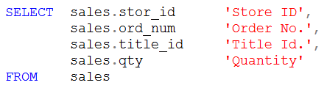
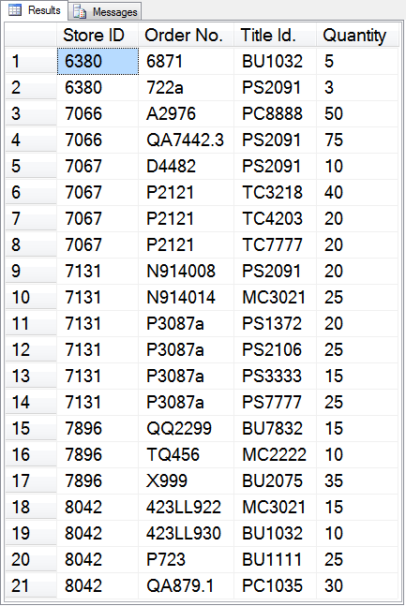
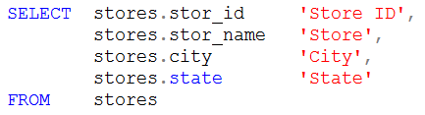
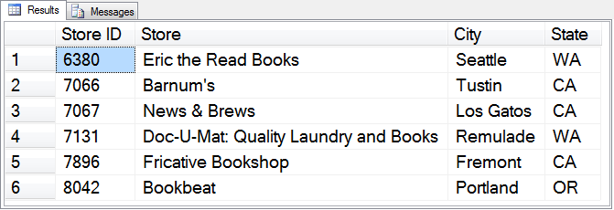
Show the store and sale information for all books sold. Include the store’s ID, name, city and state along with the sale’s order number, title ID and quantity sold.
Notes:
SELECT stores.stor_id 'Store ID',
stores.stor_name 'Store',
stores.city 'City',
stores.state 'State'
FROM stores
SELECT sales.stor_id 'Store ID',
sales.ord_num 'Order No.',
sales.title_id 'Title Id.',
sales.qty 'Quantity'
FROM sales
SELECT stores.stor_id 'Store ID',
stores.stor_name 'Store',
stores.city 'City',
stores.state 'State',
sales.ord_num 'Order No.',
sales.title_id 'Title Id.',
sales.qty 'Quantity'
FROM stores
INNER JOIN sales
ON stores.stor_id = sales.stor_id

Slide 26
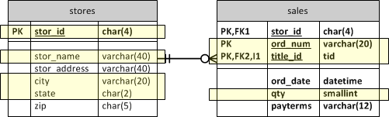
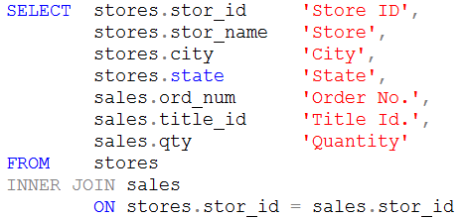
Show the store and sale information for all books sold. Include the store’s ID, name, city and state along with the sale’s order number, title ID and quantity sold.
Notes:
SELECT stores.stor_id 'Store ID',
stores.stor_name 'Store',
stores.city 'City',
stores.state 'State'
FROM stores
SELECT sales.stor_id 'Store ID',
sales.ord_num 'Order No.',
sales.title_id 'Title Id.',
sales.qty 'Quantity'
FROM sales
SELECT stores.stor_id 'Store ID',
stores.stor_name 'Store',
stores.city 'City',
stores.state 'State',
sales.ord_num 'Order No.',
sales.title_id 'Title Id.',
sales.qty 'Quantity'
FROM stores
INNER JOIN sales
ON stores.stor_id = sales.stor_id

Slide 27
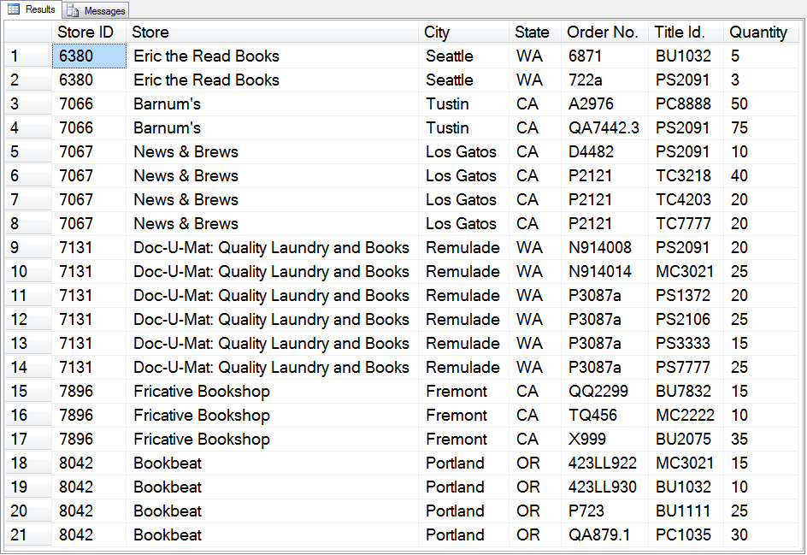
Show the store and sale information for all books sold. Include the store’s ID, name, city and state along with the sale’s order number, title ID and quantity sold.
Notes:
SELECT stores.stor_id 'Store ID',
stores.stor_name 'Store',
stores.city 'City',
stores.state 'State'
FROM stores
SELECT sales.stor_id 'Store ID',
sales.ord_num 'Order No.',
sales.title_id 'Title Id.',
sales.qty 'Quantity'
FROM sales
SELECT stores.stor_id 'Store ID',
stores.stor_name 'Store',
stores.city 'City',
stores.state 'State',
sales.ord_num 'Order No.',
sales.title_id 'Title Id.',
sales.qty 'Quantity'
FROM stores
INNER JOIN sales
ON stores.stor_id = sales.stor_id

Slide 28
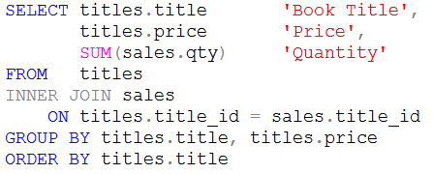
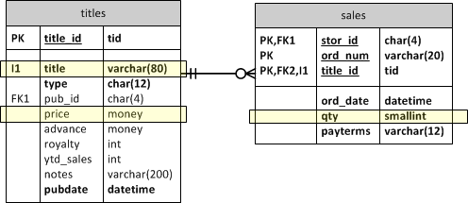

Slide 29
